Slide 1
Applying Data Warehouse Techniques

Slide 2
About Me
Tennessee Tech - Computer Science
Nashville Native
Working with SQL Server since 2010
Mostly Data Warehousing/Business Intelligence
Some Application Development
Twitter: @SpencerSwindell
Email: spencer.swindell@gmail.com

Slide 3

Think Data Insights
Modern Data Warehouse Design and Architecture
On-Premise SQL Server and Azure Data Platform
PowerBI Solutions and Training
Advanced Analytics and Machine Learning
Based in Nashville, TN
Microsoft Gold Partner

Slide 4
Overview
The Case for a Data Warehouse
Building the Warehouse
Dimensional Modeling
Using the Data Warehouse
Building a dashboard with PowerBI
Machine Learning
Demo will be based on Freddie Mac Data
Loans from 1999 – 2016
~22 million loans
~1 billon service records (3 commas club!)

Slide 5
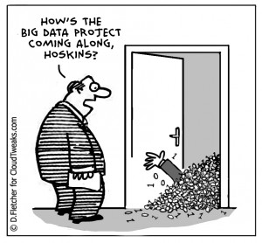
Value of a Data Warehouse
Data can be stored an used in many forms in a business
Application Databases
Excel workbooks
3rd party applications/data sources
Event stream
NoSQL Databases
Would like to analyze data across all these sources
Data can be loaded into a centralized data warehouse for analysis

Slide 6
OLTP vs OLAP
Application systems are typically optimized for dealing with a few rows of data at a time
On-Line Transactional Processing (OLTP)
Usually working with a single record at a time
Processing a sales transaction, looking up a sales record for a return
This is inefficient for analytical processing
Working with thousands to millions of records at a time
On-Line Analytical Processing (OLAP)
Viewing Total Sales Orders by Sales Territory for FY 2016

Slide 7
ColumnStore Indexing
Data traditionally stored row by row
Think of it like a CSV
The entire row is read from disk every time
ColumnStore stores data column-wise
Columns are stored separately
Rows are “reconstructed” at query time
Large gains in compression and performance
Super fast for aggregate queries!

Slide 8
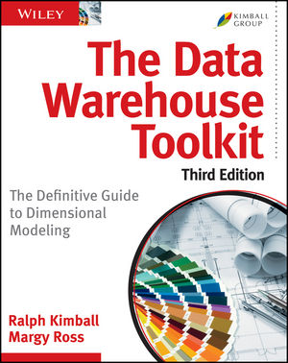
The Dimensional Model
Popularized by Ralph Kimball (The Data Warehouse Toolkit)
ETL Processes data from source systems into a dimensional model
The ETL will be about 70% of a DW Project
Dimensional Models contain two types of tables
Dimension Tables
Nouns of the business – Describe the business process
Examples: Date, Customer, Product, Store, Geography, Employee
Fact Tables
Verbs of the business – Measure the business process
Examples: Sales, Patient Visit, Inventory, Attendance, Claims
Gives us Scalability, Performance, and Simplicity

Slide 9
But don’t take my word for it
“In general, a star schema following Kimball modeling techniques is the optimal data model to build into a Tabular model. “
Performance Tuning of Tabular Models in SSAS 2012
https://docs.microsoft.com/en-us/previous-versions/sql/sql-server-2012/dn393915(v=msdn.10)
This will also apply to PowerBI modeling

Slide 10
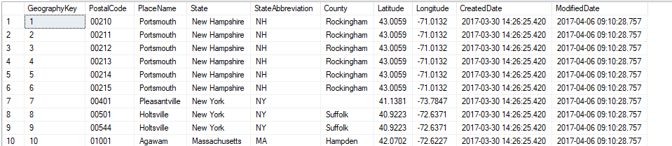
Dimension Tables
Holds descriptive characteristics of a business process
De-normalized tables allows for simple queries
Dimension tables are small compared to fact tables
Surrogate Key generated for each row and used in fact table
Allows for single column joins using integers

Slide 11
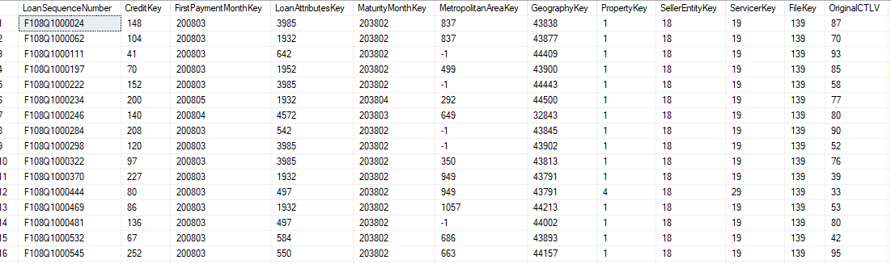
Fact Tables
Largest tables in the warehouse
Columns are surrogate keys to dimensions and measurement values
Typically will have millions of rows, in some cases billions
Defined by the Grain
The grain indicates what an individual row represents in a fact table
“One row per line item in a sales transaction”

Slide 12
Star Schema

Slide 13
Kimball Design Process
1. Identify the Business Process
2. Declare the Grain
3. Identify Dimensions
4. Identify Measures

Slide 14
Slowly Changing Dimensions
Type I – Update the record, historical data no persevered
Type II – Add a new row, historical data persevered
Type III – Add a new column, allows for comparative analysis

Slide 15
Type I Dimension Updates
Initial State:
Updated State:

Slide 16
Type II Dimension Updates
Demo

Slide 17
Type III Dimension Updates
Initial State:
Updated State:

Slide 18
Other Dimensions
Other Types of Dimensions
Mini-Dimension (Type IV)
Subset of data to reduce table size of a large dimension
Type VI
Combination of techniques in types 1,2 and 3 (1+2+3 = 6)
Junk Dimension
Low cardinality elements combined into a single dimension
Degenerate Dimension
High cardinality elements left on fact table
Role-Playing Dimension
A dimension used many times in single business process

Slide 19
Type of Fact Tables
Multiple ways to measure and store business events
Some of these are used together to create a complete picture
Transactional Fact Table
Records events as they occur
Data is typically not revisited
Periodic Snapshot Fact Table
Events are measured on intervals
Data is not revisited, new snapshots are inserted into the table
Accumulating Snapshot Fact Table
Used for tables with defined beginning, intermediate, and end milestones
Data is revisited and updated with new information

Slide 20
FreddicMac Data
Data from from Freddie Mac
Home Mortgages originating from January 1999 through March 2017
22,942,396 Loans
1,080,321,205 Loan Payments
All loans are Fixed Rate, 15/20/30 Terms
Data feed into cube
Dashboard with PowerBI
Return Interest Rate based on historical data
Code: https://github.com/shswindell42/Freddie

